Slide 1
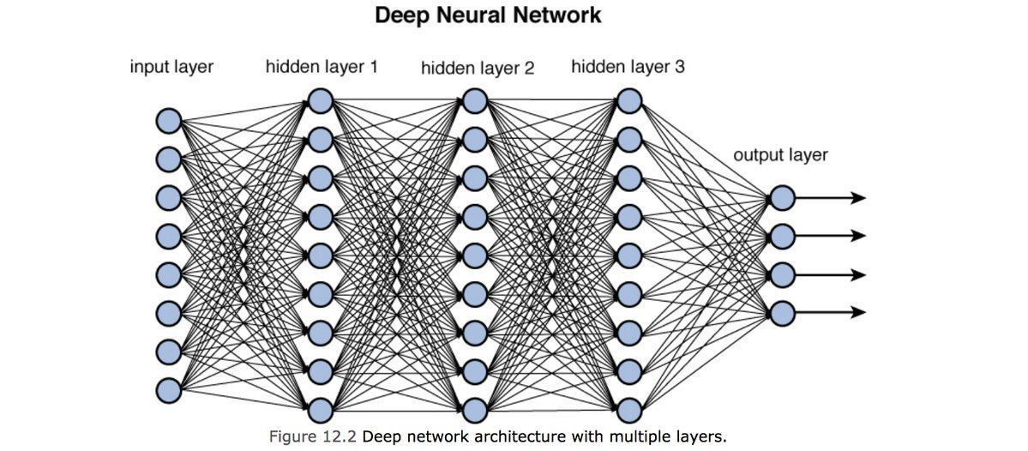
Source: https://towardsdatascience.com/training-deep-neural-networks-9fdb1964b964

